Slide 1

Advances of Machine Learning in Finance: OLS and LASSO regressions in R
Hadi Movaghari
2022-2023

Slide 2
Outline
Section 1: Preliminaries
Section 2:
Section 3:
Advances of Machine Learning in Finance: OLS and LASSO regressions in R
University of Glasgow
2022-2023

Slide 3
Section 1: Preliminaries

Slide 4
LASSO regression
Least Absolute Shrinkage and Selection Operator (LASSO) is a method for variable selection in regression analysis
LASSO is developed by Tibshirani (1996), originally based on the idea in ridge regression of Hoerl and Kennard (1970)
The LASSO has created a broad class of variables election methods called: penalized variable selection
Advances of Machine Learning in Finance: OLS and LASSO regressions in R
University of Glasgow
2022-2023

Slide 5
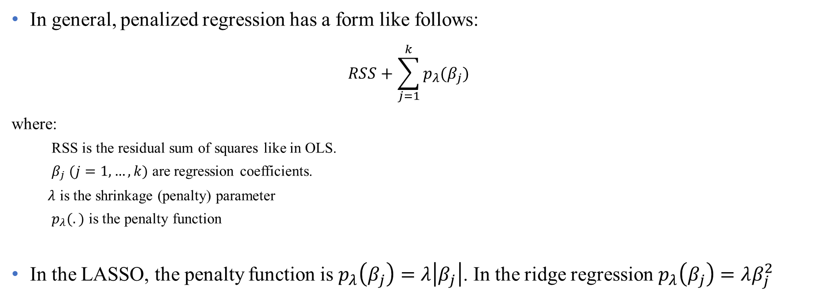
LASSO regression (Cont’d)
In general, penalized regression has a form like follows:
$$RSS+\sum_{j=1}^{k}{p_{λ}(β_{j})}$$
where:
RSS is the residual sum of squares like in OLS.
$β_{j} (j=1,…,k)$ are regression coefficients.
$λ$ is the shrinkage (penalty) parameter
$p_{λ}(.)$ is the penalty function
In the LASSO, the penalty function is $p_{λ}\left(β_{j}\right)=λ\left|β_{j}\right|$. In the ridge regression $p_{λ}\left(β_{j}\right)=λβ_{j}^{2}$
Advances of Machine Learning in Finance: OLS and LASSO regressions in R
University of Glasgow
2022-2023

Slide 6
LASSO regression (Cont’d)
Generalizations of the LASSO
Bridge regression (Fu, 1998)
SCAD (Fan & Li, 2001)
Elastic Net (Zou & Hastie, 2005)
Fused LASSO (Tibshirani, et al., 2005)
Group LASSO (Yuan & Lin, 2006)
Adaptive LASSO (Zou, 2006)
For a complete review, see Hastie et al. (2015)
Advances of Machine Learning in Finance: OLS and LASSO regressions in R
University of Glasgow
2022-2023

Slide 7
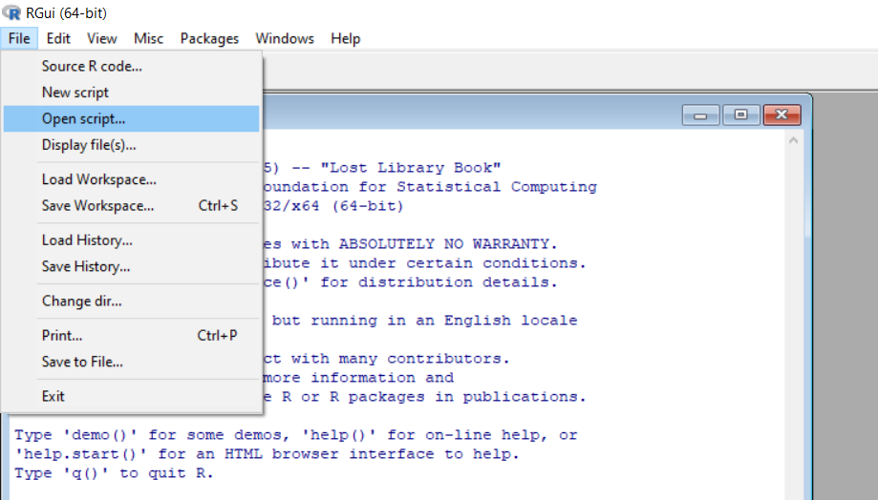
Open your script file!
Download files (script, data, PowerPoint) from Moodle or https://github.com/hadigilan/AIFinance_genetic_algorithm.git
From File -> Open script find your file and then open
Advances of Machine Learning in Finance: OLS and LASSO regressions in R
University of Glasgow
2022-2023

Slide 8
R packages for LASSO
There are different R packages to conduct LASSO regression using different algorithm, like:
lassoshooting which utilize shooting algorithm of Fu (1998)
lars which utilizes least angle regression of Efron et al. (2004)
glmnet which utilizes cyclical coordinate descent algorithm of Friedman et al. (2010)
We use the package glmnet, perhaps the most powerful R package for LASSO regression
For detailed applications of glmnet, see James et al. (2017)
Advances of Machine Learning in Finance: OLS and LASSO regressions in R
University of Glasgow
2022-2023

Slide 9
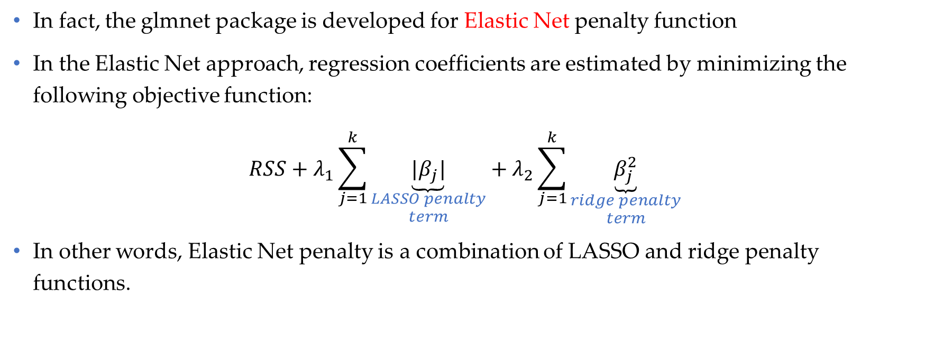
glmnet package
In fact, the glmnet package is developed for Elastic Net penalty function
In the Elastic Net approach, regression coefficients are estimated by minimizing the following objective function:
$$RSS+λ_{1}\sum_{j=1}^{k}{\underset{\begin{aligned}LASSO penalty \\ term\end{aligned}}{\underbrace{|β_{j}|}}}+λ_{2}\sum_{j=1}^{k}{\underset{\begin{aligned}ridge penalty \\ term\end{aligned}}{\underbrace{β_{j}^{2}}}}$$
In other words, Elastic Net penalty is a combination of LASSO and ridge penalty functions.
Advances of Machine Learning in Finance: OLS and LASSO regressions in R
University of Glasgow
2022-2023

Slide 10
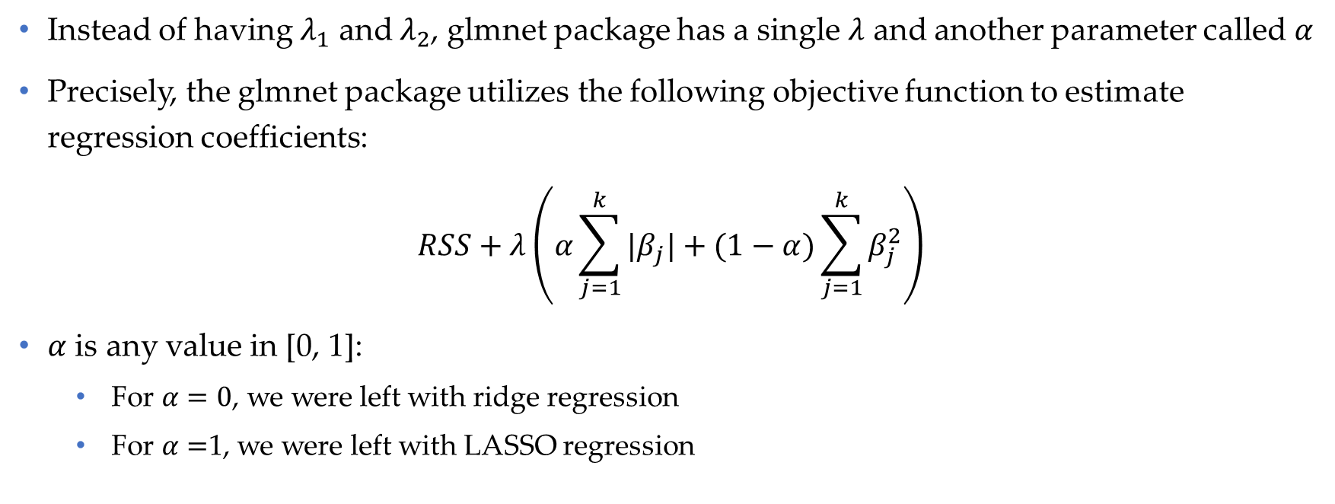
glmnet package (Cont’d)
Instead of having $λ_{1}$ and $λ_{2}$, glmnet package has a single $λ$ and another parameter called $α$
Precisely, the glmnet package utilizes the following objective function to estimate regression coefficients:
$$RSS+λ\left(α\sum_{j=1}^{k}{|β_{j}|}+(1−α)\sum_{j=1}^{k}{β_{j}^{2}}\right)$$
$α$ is any value in [0, 1]:
For $α=0$, we were left with ridge regression
For $α=$1, we were left with LASSO regression
Advances of Machine Learning in Finance: OLS and LASSO regressions in R
University of Glasgow
2022-2023

Slide 11
The package (Cont’d)
The main function in the GA package is ga with the following main arguments:
type
The nature of decision variables
fitness
The name of objective function
A vector of length equal to the decision variables providing the minimum of the search space
upper
lower
maxiter
A vector of length equal to the decision variables providing the maximum of the search space
nBits
The maximum number of iterations before the GA search is halted
A value specifying the number of bits to be used in binary optimizations
Advances of Machine Learning in Finance: OLS and LASSO regressions in R
University of Glasgow
2022-2023

Slide 12
The package (Cont’d)
To run the ga function, we need at least:
For continuous search: arguments type, fitness, lower and upper.
For binary search: arguments type, fitness, nBits.
In addition to final solution, ga provides several other outputs, e.g., the value of function in each iteration, etc.
Advances of Machine Learning in Finance: OLS and LASSO regressions in R
University of Glasgow
2022-2023

Slide 13
glmnet package
In fact, the glmnet package is developed for Elastic Net penalty function
To install the package and load it, run the following codes:
install.packages(“GA")
library(GA)
You can download the manual of the package from https://cran.r-project.org/web/packages/GA/GA.pdf
You can cite the package in your publication
citation("GA")
Advances of Machine Learning in Finance: OLS and LASSO regressions in R
University of Glasgow
2022-2023

Slide 14
References
Efron, B., Hastie, T., Johnstone, I., & Tibshirani, R. (2004). Least angle regression. The Annals of statistics, 32(2), 407-499.
Fan, J., & Li, R. (2001). Variable selection via nonconcave penalized likelihood and its oracle properties. Journal of the American statistical Association, 96(456), 1348-1360.
Friedman, J., Hastie, T., & Tibshirani, R. (2010). Regularization paths for generalized linear models via coordinate descent. Journal of statistical software, 33(1), 1.
Fu, W. J. (1998). Penalized regressions: the bridge versus the lasso. Journal of computational and graphical statistics, 7(3), 397-416.
Hastie, T., Tibshirani, R., & Wainwright, M. (2015). Statistical Learning with Sparsity: The Lasso and Generalizations. CRC Press.
Hoerl, A. E., & Kennard, R. W. (1970). Ridge regression: Biased estimation for nonorthogonal problems. Technometrics, 12(1), 55-67.
James, G., Witten, D., Hastie, T., & Tibshirani, R. (2017). An introduction to statistical learning with applications in R New York: springer.
Tibshirani, R. (1996). Regression shrinkage and selection via the lasso. Journal of the Royal Statistical Society: Series B (Methodological), 58(1), 267-288.
Tibshirani, R., Saunders, M., Rosset, S., Zhu, J., & Knight, K. (2005). Sparsity and smoothness via the fused lasso. Journal of the Royal Statistical Society: Series B (Statistical Methodology), 67(1), 91-108.
Yuan, M., & Lin, Y. (2006). Model selection and estimation in regression with grouped variables. Journal of the Royal Statistical Society: Series B (Statistical Methodology), 68(1), 49-67.
Zou, H. (2006). The adaptive lasso and its oracle properties. Journal of the American statistical association, 101(476), 1418-1429.
Zou, H., & Hastie, T. (2005). Regularization and variable selection via the elastic net. Journal of the royal statistical society: series B (statistical methodology), 67(2), 301-320.
Advances of Machine Learning in Finance: OLS and LASSO regressions in R
University of Glasgow
2022-2023

Slide 15
Contact
If you have any question regarding R programming and financial econometrics, or any suggestion to improve the teaching style, please feel free to contact me through:
hadi.movaghari@glasgow.ac.uk
Advances of Machine Learning in Finance: OLS and LASSO regressions in R
University of Glasgow
2022-2023

